Slide 1






Name: James Onyejizu
Project Name: Off-Policy Evaluation for Safe Offline Reinforcement Learning
Pillar: Artificial Intelligence
Contact Details:
James.Onyejizu@ibm.com James.Kel71@gmail.com
James Onyejizu
Social Media:
ADD PHOTO HERE
James Onyejizu
@JOnyejizu
Kaycee_fresh

Slide 2
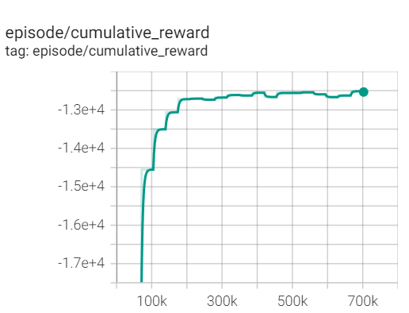
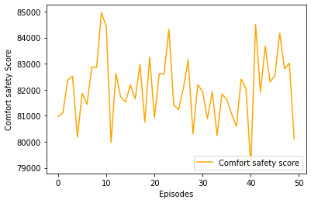
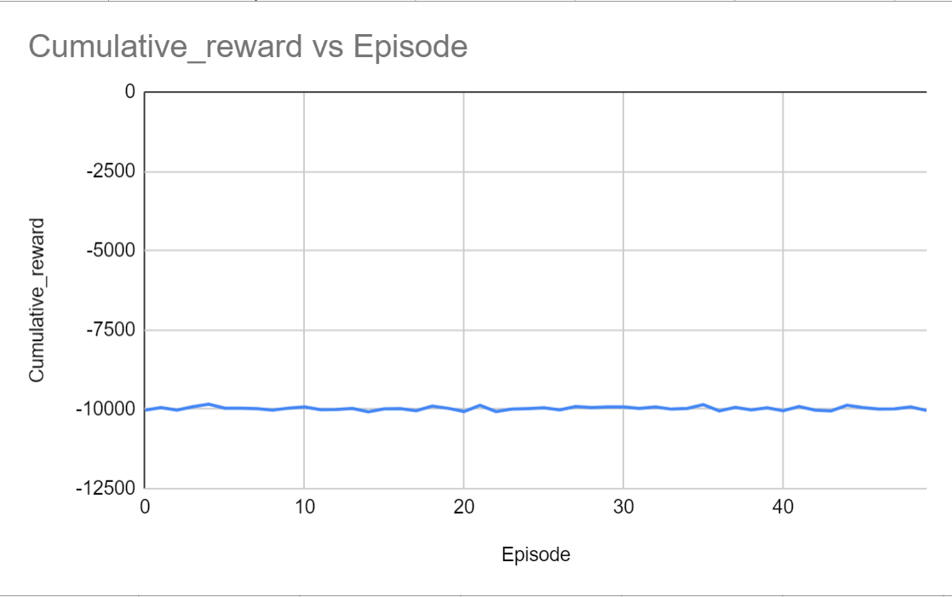
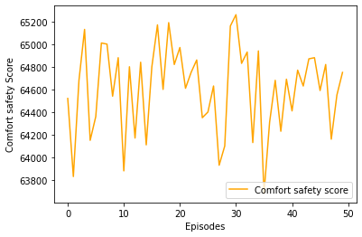
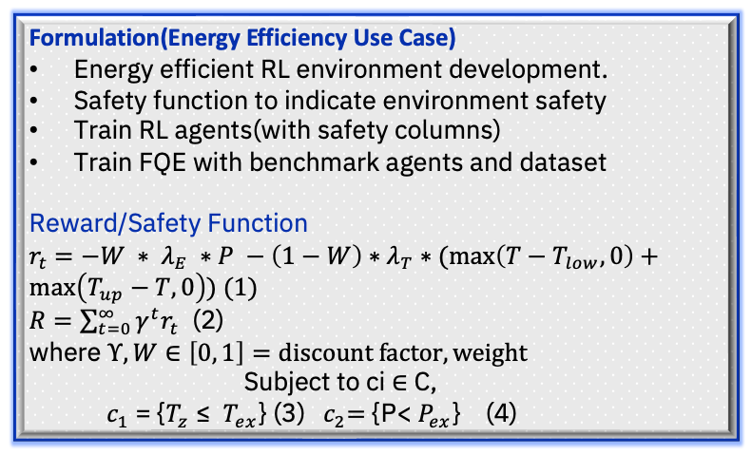
Off-Policy Evaluation for Safe Offline Reinforcement Learning
Manager: Dharmashanker Subramanian
Mentors: Long Vu, Lan Hoang
Why Safe RL?
Respect safety constraints for improved/realistic system performance(Thermal control in buildings).
Project Overview
Off-policy evaluation leverages offline log data in decision making.
Why OPE:
high stakes and expensive settings.
Approach:
Fitted Q-Evaluation(FQE): uses iterative regression in decision making.
Our Contribution(Safe FQE):
Why Safe FQE? Current FQE takes a single metric – In real world situations, we need to consider multiple scenarios + safety-critical measures.
Current Results
Analysis
The cumulative reward for the PPO agent was comparable to the rule based agent, but received a lower safety score.
Next step
Train FQE with benchmark agents and generated dataset.
Current Results
Fig 1-2: Training using a DRL agent(PPO)
Project’s Current State
Fig 5: Train FQE
Benchmark Agents(CQL,
BCQ)
FQE with safety and performance evaluators
Benchmark
Environments
Fig 3-4: Training using a Rule-based agent
Formulation(Energy Efficiency Use Case)
Energy efficient RL environment development.
Safety function to indicate environment safety
Train RL agents(with safety columns)
Train FQE with benchmark agents and dataset
Reward/Safety Function
$r_{t}$ $=−W ∗ λ_{E} ∗P −\left(1−W\right)∗λ_{T}∗(\max\left(T−T_{low},0\right)+\max\left(T_{up}−T,0\right)) (1)$
$R=\sum_{t=0}^{∞}{γ^{t}r_{t}}$ (2)
where $Υ, W∈\left[0, 1\right]=discount factor, weight$
$$\text{Subject} \text{to} \text{ci}\text{ ∈ }\text{C}\text{,}$$
$c_{1} \text{= }\text{\{}T_{z}\text{ ≤ }$ $T_{ex}$} (3) ${ c}_{2}=$ {P< $P_{ex}$} (4)
Fig 1-2: Training using a DRL agent(PPO)
Future Work
How to combine the objectives? (weighted + safety threshold?)
Can FQE be viewed in a distributional way i.e. potential different dataset for FQE fit + test and observations to be evaluated
References
https://realworldsdm.github.io/paper/34.pdf
https://arxiv.org/pdf/2002.03478.pdf -> adding expert knowledge
Name: James Onyejizu Email: James.Onyejizu@ibm.com

